Slide 1

Project Proposal Presentation
On
A WEB-BASED EDUCATION PORTAL APPLICATION FOR CRAWFORD UNIVERSITY USING CODEIGNITER FRAMEWORK
By
Eniola Oluwatobi Akinlonu
150502043
Computer Science
Supervisor: Miss. Adewale Victoria

Slide 2
PRESENTATION OUTLINE
Introduction
Statement of the problem
Aim and objectives
Significance
Methodology
Conclusion

Slide 3
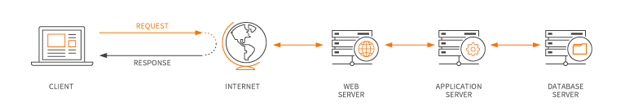
INTRODUCTION
A Web-based Education Portal Application

Slide 4
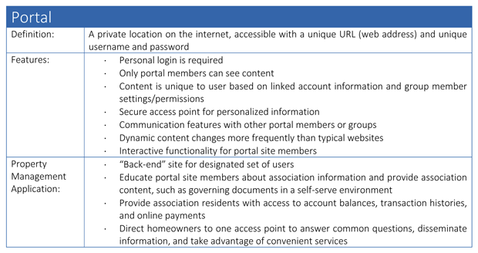
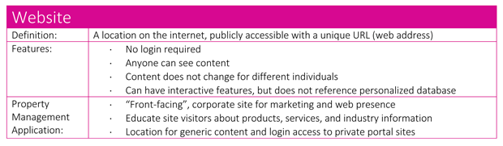

Slide 5
STATEMENT OF THE PROBLEM
Inefficiency: Slow page load and response time.
Under implemented: Persistent and offensive dialog on page load that threatens satisfactory user interaction, broken links, duplicate and redundant links, unimplemented functionality, use of anachronistic technologies and defective user interface and poor user experience, no online help. User has to go to the edu-portal office to manually set a new password for his/her account.
Unreliable and insecure as server breaks down and students are unable to access the portal and it has no active SSL (Secure Sockets Layer) certificate i.e it doesn’t use Https (Hypertext Transfer Protocol Secure) protocol.

Slide 6
AIM AND OBJECTIVES
To create an embedded online course portal which provides a pre-assessment module that allow courses verification to the students when login on the website and result checking by students. In addition, the course portal can also automatically evaluate and showcase the report of courses of the students.
Course allocation, approval, course grading and result processing by lecturers.
Position-based user restriction, bursary approval and dispensation of clearance to qualified users, mailing, admission list management, user data management.
To improve the privacy, user-friendliness and to enable convenient access to the different kinds of information and services mounted on the web by users, it would be desirable to set up a portal for channeling the vast information resources to the different users in an efficient and effective manner.

Slide 7
SIGNIFICANCE
The study will be beneficial to the following:
To the Students
To the Academic officers
To the Future Researchers
Project Supervisors

Slide 8
METHODOLOGY
Language: PHP
Framework: codeigniter
Architectural pattern: Model View Controller
Database: MySql

Slide 9
CONCLUSION

